Slide 1
Game Of Life

Slide 2
Memory Layout of a 2D array in C
M_{0,0}
M_{1,0}
M_{2,0}
M_{3,0}
M_{0,1}
M_{1,1}
M_{2,1}
M_{3,1}
M_{0,2}
M_{1,2}
M_{2,2}
M_{3,2}
M_{0,3}
M_{1,3}
M_{2,3}
M_{3,3}
M
M_{0,0}
M_{1,0}
M_{2,0}
M_{3,0}
M_{0,1}
M_{1,1}
M_{2,1}
M_{3,1}
M_{0,2}
M_{1,2}
M_{2,2}
M_{3,2}
M_{0,3}
M_{1,3}
M_{2,3}
M_{3,3}

Slide 3
Memory Layout of a 2D array in C
Board
1 | 1 | 1 | 1
1 | 1 | 1 | 1
0 | 1 | 1 | 0
0 | 0 | 0 | 1

Slide 4
Memory Layout of a 2D array in C
Board
1 | 1 | 1 | 1
1 | 1 | 1 | 1
0 | 1 | 1 | 0
0 | 0 | 0 | 1

Slide 5
Memory Layout of a 2D array in C
4x4
Board
1 | 1 | 1 | 1
1 | 1 | 1 | 1
0 | 1 | 1 | 0
0 | 0 | 0 | 1
Board 16
1 | 1 | 1 | 1 | 1 | 1 | 1 | 1 | 0 | 1 | 1 | 0 | 0 | 0 | 0 | 1
0 | 1 | 2 | 3 | 4 | 5 | 6 | 7 | 8 | 9 | 10 | 11 | 12 | 13 | 14 | 15

Slide 6
Memory Layout of a 2D array in C
1 | 1 | 1 | 1
1 | 1 | 1 | 1
0 | 1 | 1 | 0
0 | 0 | 0 | 1
4x4
1 | 1 | 1 | 1 | 1 | 1 | 1 | 1 | 0 | 1 | 1 | 0 | 0 | 0 | 0 | 1
0 | 1 | 2 | 3 | 4 | 5 | 6 | 7 | 8 | 9 | 10 | 11 | 12 | 13 | 14 | 15

Slide 7
Memory Layout of a 2D array in C
1 | 1 | 1 | 1
1 | 1 | 1 | 1
0 | 1 | 1 | 0
0 | 0 | 0 | 1
4x4
1 | 1 | 1 | 1 | 1 | 1 | 1 | 1 | 0 | 1 | 1 | 0 | 0 | 0 | 0 | 1
0 | 1 | 2 | 3 | 4 | 5 | 6 | 7 | 8 | 9 | 10 | 11 | 12 | 13 | 14 | 15

Slide 8
Memory Layout of a 2D array in C
1 | 1 | 1 | 1
1 | 1 | 1 | 1
0 | 1 | 1 | 0
0 | 0 | 0 | 1
4x4
Above=5-4=1
1 | 1 | 1 | 1 | 1 | 1 | 1 | 1 | 0 | 1 | 1 | 0 | 0 | 0 | 0 | 1
0 | 1 | 2 | 3 | 4 | 5 | 6 | 7 | 8 | 9 | 10 | 11 | 12 | 13 | 14 | 15

Slide 9
Memory Layout of a 2D array in C
1 | 1 | 1 | 1
1 | 1 | 1 | 1
0 | 1 | 1 | 0
0 | 0 | 0 | 1
4x4
Above=5-4=1
Below=5+4=9
1 | 1 | 1 | 1 | 1 | 1 | 1 | 1 | 0 | 1 | 1 | 0 | 0 | 0 | 0 | 1
0 | 1 | 2 | 3 | 4 | 5 | 6 | 7 | 8 | 9 | 10 | 11 | 12 | 13 | 14 | 15

Slide 10
Memory Layout of a 2D array in C
1 | 1 | 1 | 1
1 | 1 | 1 | 1
0 | 1 | 1 | 0
0 | 0 | 0 | 1
4x4
Above=5-4=1
Below=5+4=9
Upper left=5-4-1=9
1 | 1 | 1 | 1 | 1 | 1 | 1 | 1 | 0 | 1 | 1 | 0 | 0 | 0 | 0 | 1
0 | 1 | 2 | 3 | 4 | 5 | 6 | 7 | 8 | 9 | 10 | 11 | 12 | 13 | 14 | 15

Slide 11
Memory Layout of a 2D array in C
1 | 1 | 1 | 1
1 | 1 | 1 | 1
0 | 1 | 1 | 0
0 | 0 | 0 | 1
4x4
Above=5-4=1
Bottom left=5+4-1=8
Below=5+4=9
Bottom right=5+4+1=10
Upper left=5-4-1=0
1 | 1 | 1 | 1 | 1 | 1 | 1 | 1 | 0 | 1 | 1 | 0 | 0 | 0 | 0 | 1
0 | 1 | 2 | 3 | 4 | 5 | 6 | 7 | 8 | 9 | 10 | 11 | 12 | 13 | 14 | 15

Slide 12
Memory Layout of a 2D array in C
1 | 1 | 1 | 1
1 | 1 | 1 | 1
0 | 1 | 1 | 0
0 | 0 | 0 | 1
NxN
(i,j)=(1,1)
i*N+j=1*4+1=5
1 | 1 | 1 | 1 | 1 | 1 | 1 | 1 | 0 | 1 | 1 | 0 | 0 | 0 | 0 | 1
0 | 1 | 2 | 3 | 4 | 5 | 6 | 7 | 8 | 9 | 10 | 11 | 12 | 13 | 14 | 15

Slide 13
Memory Layout of a 2D array in C
(i,j)=(1,1)
1 | 1 | 1 | 1
1 | 1 | 1 | 1
0 | 1 | 1 | 0
0 | 0 | 0 | 1
NxN=4x4
Bottom left=
5+N-1=5+4-1=8
i*N+j=1*4+1=5
Above=5-N=5-4=1
Bottom right=
5+N+1=5+4+1=10
Below=5+N=5+4=9
Upper left=5-N-1=5-4-1=0
1 | 1 | 1 | 1 | 1 | 1 | 1 | 1 | 0 | 1 | 1 | 0 | 0 | 0 | 0 | 1
0 | 1 | 2 | 3 | 4 | 5 | 6 | 7 | 8 | 9 | 10 | 11 | 12 | 13 | 14 | 15

Slide 14
Memory Layout of a 2D array in C
ith cell with NxN size.
(i,j)=(1,1)
i*N+j=1*4+1=5
Above=i-N
Below=i+N
Upper left=i-N-1
Bottom left=i+N-1
Bottom right=i+N+1

Slide 15
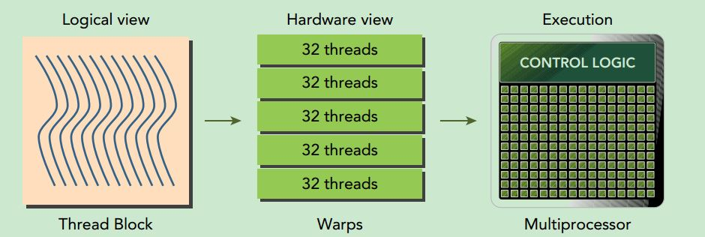
Warps
Warps are the basic unit of execution in an SM.
When you launch a grid of thread blocks, the thread blocks in the grid are distributed among SMs.
Once a thread block is scheduled to an SM, threads in the thread block are further partitioned into warps.

Slide 16
Warps
A warp consists of 32 consecutive threads and all threads in a warp are executed in Single Instruction Multiple Thread (SIMT) fashion; that is, all threads execute the same instruction, and
each thread carries out that operation on its own private data.
The following figure illustrates the relationship between the logical view and hardware view of a thread block.

